Slide 1
DATATHON @ UNIVERSITY OF MACEDONIA Thessaloniki, December 2018
Alumni & students of department of Business Administration
Alamanis Konstantinos
Zacharioudakis Stylianos
Kokovidis Symeon
Raptis Dimos

Slide 2
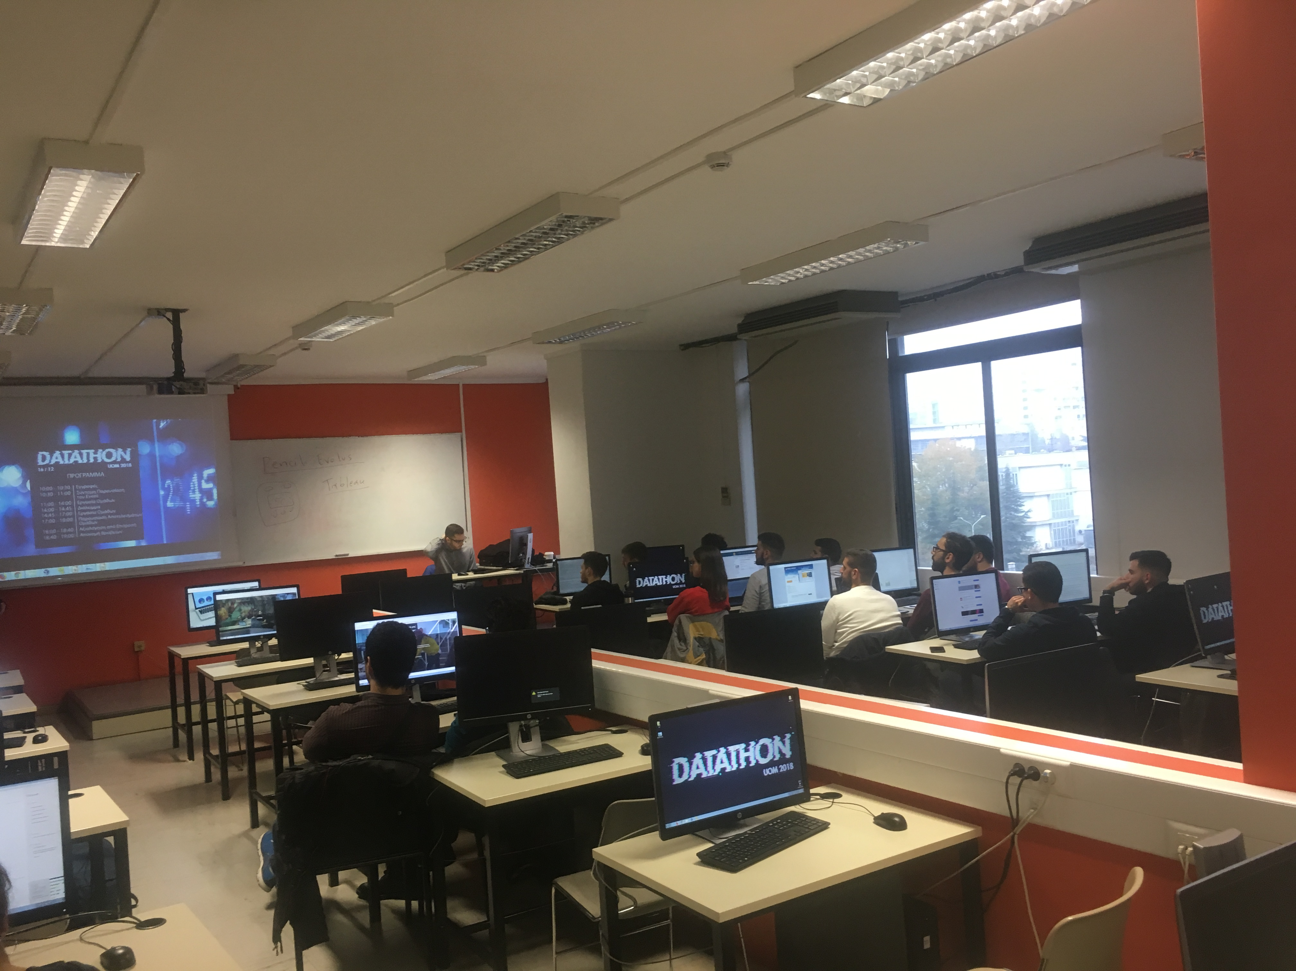
The competition:
Innovation
Developing business ideas, solutions or apps based on open data
Data analysis to make a better city

Slide 3
Our idea:
Measure the quality of life of the citizen by municipal unity
Define the factors that affect the quality of life of the citizen
Quantification of the factors and create indicators for every factor
Use these indicators for improvements, conclusions and proposals in Thessaloniki

Slide 4
The 5 factors:
Parking spaces for disabled people
Population concentration (factor related to security for contingent situations
Bike spaces
Air pollution
Population per municipal unity

Slide 5
Stage 1 - Preparation
Pumping data from various datasets:
Read & cleaning data
Select the appropriate data
Define the shape of the final table
Define the type of analysis that we’ll use
Division of tasks

Slide 6
Stage 2 – Data Analysis
Tableau / QGIS – Visualization of municipal unities on the map and extract geographical data
IBM SPSS – Using the Ζ score of values for normalization & comparability
Microsoft Excel – Cleaning data, average values, sums, creation of the final board

Slide 7
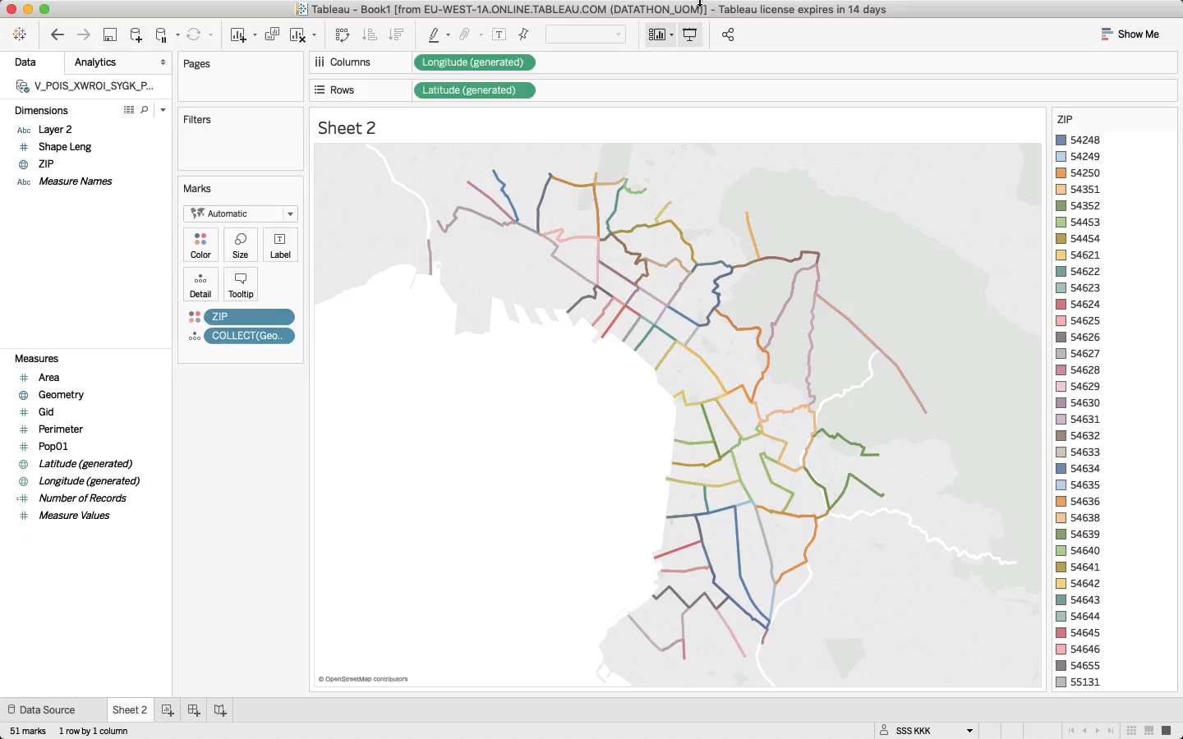
Tableau (Video Demonstration)

Slide 8
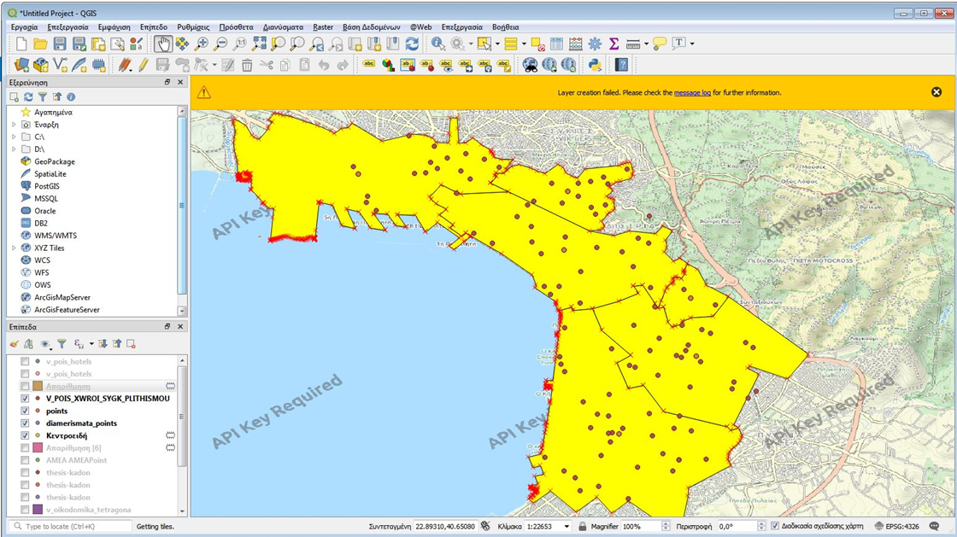
QGIS

Slide 9
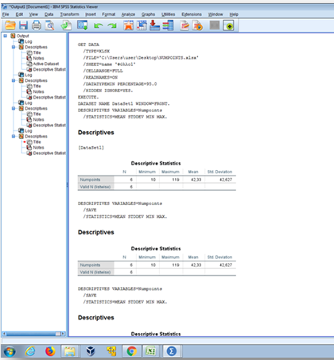
Z scores through SPSS

Slide 10
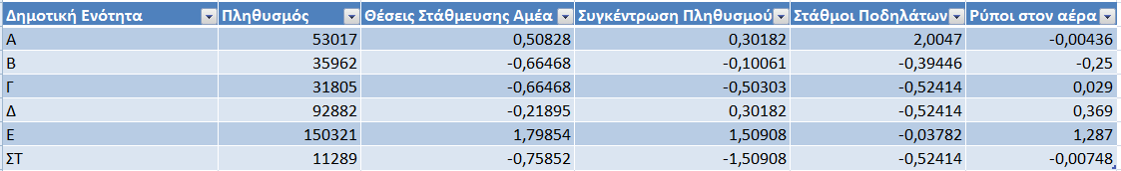
Stage 3 – Presentation of the final board (Z-scores)
Indicator > 0 – Indicator is (value)*std above the mean
Indicator < 0 – Indicator is (value)*std below the mean

Slide 11
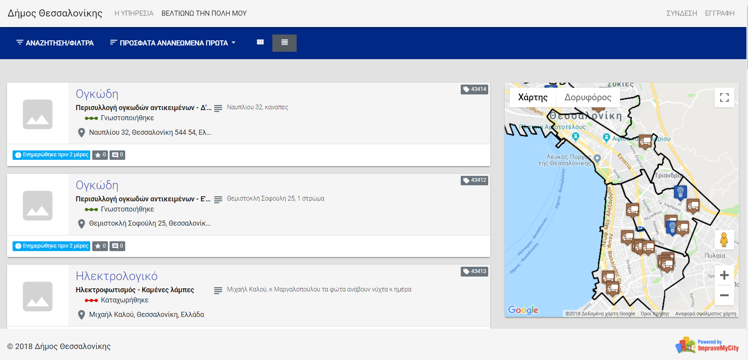
Proposals
https://imc.thessaloniki.gr/imc

Slide 12
Thank you for your attention!

